Slide 1


Predicting Silver Prices
Silver Panel Manufacturing
April 1, 2025
Michelle Nelson

Slide 2

Agenda
Introduction & background
Question & hypothesis
Summary of analysis process
Findings
Limitations
Proposed actions
Expected Benefits

Slide 3
Introduction & Background
Master of Science, Data Analytics
Bachelor of Science, Mathematics
Business Analyst for 5 years

Slide 4

Question & Hypothesis
Let’s dive in

Slide 5

Question & Hypotheses
Can a ridge regression or time series model be constructed on the silver pricing dataset?
Null Hypothesis: A predictive ridge regression model with a model accuracy greater than 70% cannot be constructed on the market research dataset.
Alternative Hypothesis: A predictive ridge regression model with a model accuracy greater than 70% can be constructed on the market research dataset.

Slide 6

Data Analysis Process
A brief summary

Slide 7
Process Overview
Business Question
Get Data
Explore Data
Prepare Data
Analyze Data
Define question, objectives, hypotheses, and context of question.
Identify dataset necessary to answer the business question.
Explore what the data looks like
Test for normality
Understand the data’s ranges, means, and modes
Start to determine which model may be appropriate
Clean data for missing values, duplicates, and outliers
Correct formatting
Merge datasets
Standardize data to a scale
Split data into training and testing sets
Fit a model to the data
Test model and check accuracy
Explore assumptions of model
Revise model with new features
Test new model and check accuracy

Slide 8

The Data
The dataset included:
Date of record (graphing only)
Silver price in USD (dependent)
USD/AUD exchange rate
Unemployment rate
Inflation rate
Recession flag for US
Recession flag for China

Slide 9


Model Types
Ridge/Linear Regression
Polynomial Ridge/Linear Regression
Attempts to find a straight line that best fits the data.
Coefficients in the resulting equation of the line correspond to importance
Used when a straight line does not fit data well.
Coefficients function the same

Slide 10

Findings
Let’s dive in

Slide 11

Accuracy Metrics
Mean Absolute Error:
Measures the average size of error between predicted and actual values.
Is in the same units as predicted variable.
Mean Squared Error:
Measures average squared size of error between predicted and actual values.
Is in squared units—which is harder to interpret.
Root Mean Squared Error:
Measures the square root of the average squared size of error between predicted and actual values.
Is in the same units as the predicted variable.
Mean Absolute Percentage Error:
The average % difference between predicted and actual values, where error is expressed as a % of the actual value.
All metrics above are better when lower.
Notes:
MAE treats all errors equally. RMSE penalizes larger errors more heavily.

Slide 12
Model Accuracy
 | Model Metric
Mean Absolute Error | 2.57
Mean Squared Error | 13.78
Root Mean Squared Error | 3.71
Mean Absolute Percentage Error | 21.77%
Mean Absolute Error:
On average, predictions are off by $2.57 per ounce troy.
Root Mean Squared Error:
On average, predictions are off by $3.71 per ounce troy.
MAPE:
On average, predictions are off by 21.77% from actual price.
Notes:
MAE treats all errors equally. RMSE penalizes larger errors more heavily.

Slide 13
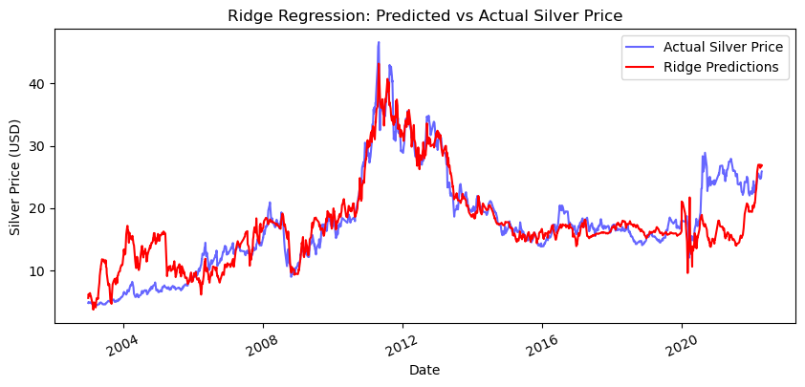
Model Prediction Graph

Slide 14
Top Predictors
Predictor | Influence
US/AUD Exchange Rate³ | -24.6
Unemployment/Inflation² Interaction | -20.2
Unemployment² | 19.3
US/AUD Exchange Rate²/Unemployment Interaction | 18.0
Unemployment³/China in Recession Interaction | 16.2
Inflation³ | 15.9
Unemployment³/US in Recession Interaction | 15.4
Unemployment/Inflation³ Interaction | -14.8
US/AUD Exchange Rate³/Unemployment Interaction | 12.6
US/AUD Exchange Rate/Unemployment Interaction | 12.5
When USD is much stronger than AUD, silver prices fall.
When inflation rises sharply during high unemployment, silver prices fall.
High unemployment drives silver prices up.
High inflation drives silver prices up.

Slide 15

Limitations & Benefits
A brief summary

Slide 16

Limitations
Interpretability of the results
Ridge regression creates coefficients that are less interpretable than ordinary linear regression.
Interaction terms are difficult.
Model is limited to finding a linear/curvilinear relationship

Slide 17

Benefits
Proactivity vs reactivity
Minimize cost/maximize profit
Warning signs

Slide 18

Proposed Actions

Slide 19

Proposed Actions
Business Actions
Data Team Actions
Buy silver when the following are true:
Exchange rate is high
Unemployment rate is low
Inflation is low
Consider interactions, especially for unemployment rate
Use predictors as warning signs of higher prices to come
Run a different predictive model—such as a random forest regressor
Does not rely on finding a linear relationship
Find a source, internal or external, of predicted macroeconomic factors.

Slide 20



Summary
There’s still room for improvement
Data Analytics can find newer, better models to make even better predictions
Silver price has warning signs
Consider macroeconomic factors before buying, including predicted rates
Let’s be proactive instead of reactive
Learn to recognize the signals of higher prices

Slide 21

Conclusion
Thank you!
With Data Analytics, we can work hard to reduce costs and make this year even better than the last!
We look forward to working together.
Michelle
mnel522@wgu.edu

